Slide 1
Lecture 35
Memory management - Paging
Dr. Ehtesham Zahoor
National University of
Computer & Emerging Sciences

Slide 2

Virtual Memory
What to do with programs too big to fit in main-memory?
  Earlier systems relied on splitting the program in pieces, called overlays
  It was the responsibility of programmer to split program

Slide 3
Virtual Memory
Allow the process size (program, data …) to exceed the amount of Physical memory available (RAM)
OS maintains bits and pieces of many programs in RAM at once
  4GB process can run on a machine with 1GB RAM by choosing which 1GB to keep in RAM

Slide 4
Principles of Virtual Memory
00000000
00000000
00000000
.
.
.
3FFFFFF
.
.
.
Physical
Memory
.
.
.
64M
FFFFFFFF
FFFFFFFF
4G
Virtual
Memory
4G
Virtual
Memory

Slide 5
Principles of Virtual Memory
00000000
00000000
00000000
Address
Map
Address
Map
.
.
.
3FFFFFF
.
.
.
Physical
Memory
.
.
.
64M
FFFFFFFF
FFFFFFFF
4G
Virtual
Memory
4G
Virtual
Memory

Slide 6
Paging
Most virtual memory systems use Paging
Idea: logical address space of a process can be made noncontiguous; process is allocated physical memory whenever the latter is available.

Slide 7
Paging
Partition memory into small equal fixed-size chunks and divide each process into the same size chunks
  The chunks of a process are called pages
  The chunks of memory are called frames

Slide 8
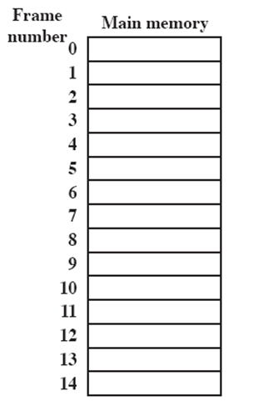
Processes and Frames
A.0
A.1
A.2
A.3
B.0
D.0
B.1
D.1
B.2
D.2
C.0
C.1
C.2
C.3
D.3
D.4
Notes:
Animated slide
System with a number of frames allocated
Process A, stored on disk, consists of four pages. When it comes time to load this process, the operating system finds four free frames and loads the four pages of process A into the four frames.
Process B, consisting of three pages, and process C, consisting of four pages, are subsequently loaded.
Then process B is suspended and is swapped out of main memory.
Later, all of the processes in main memory are blocked, and the operating system needs to bring in a new process, process D, which consists of five pages. The Operating System loads the pages into the available frames and updates the page table

Slide 9

Paging Example

Slide 10
0k – 4k
2
Physical
Address Space
4k – 8k
1
8k –12k
6
0
0k – 4k
12k-16k
0
1
4k – 8k
14k-20k
4
2
8k –12k
Virtual Address Space
20k-24k
3
12k-16k
3
24k-28k
X
4
14k-20k
28k-32k
X
5
20k-24k
32k-36k
X
6
24k-28k
36k-40k
5
7
28k-32k
40k-44k
X
44k-48k
7
MOV REG 0
MOV REG 8192
MOV REG 20500
MOV REG 12308
48k-52k
X
52k-56k
X
20500 is 20 bytes from the start of vpage 5
(20K-24K) maps to frame 3, 12288+20 = 12308
56k-60k
X
60k-64k
X

Slide 11
Paging
Only 8 pages are mapped
What if a Virtual Address between 8k – 12k is generated?
A Present/Absent bit is kept for each Page
Present/Absent bit = 1
  Page is Present in Physically Memory
Present/Absent bit = 0
  Page is not Present in Physically Memory

Slide 12
0k – 4k
X
0
4k – 8k
X
0
8k –12k
0
X
X
12k-16k
0
14k-20k
0
1
Physical Address Space
Virtual Address Space
20k-24k
X
0
24k-28k
2
1
28k-32k
X
0
32k-36k
0
0
0k – 4k
X
36k-40k
X
1
4k – 8k
0
40k-44k
1
2
8k –12k
4
44k-48k
1
3
12k-16k
3
48k-52k
7
4
14k-20k
1
52k-56k
1
5
20k-24k
1
56k-60k
1
6
24k-28k
6
5
7
28k-32k
60k-64k
1

Slide 13
Paging
If the Program generates the Virtual Address of a page that is unmapped
  Present/Absent bit = 0
MMU generates an Interrupt called Page Fault
This invokes the Operating System
  OS swaps out one of the Page from RAM
  Swaps in the required page
  Updates the Page Table

Slide 14
Multiprogramming with Paging
P2
12k-16k
1
4
P3
20k-24k
0
8k –12k
X
1
0
14k-20k
X
4k – 8k
7
0
1
12k-16k
2
0k – 4k
1
X
0
Physical Address Space
8k –12k
X
0
4k – 8k
0
X
0k – 4k
X
0
0k – 4k
0
1
4k – 8k
2
8k –12k
14k-20k
1
3
12k-16k
3
P1
0
4
14k-20k
12k-16k
X
8k –12k
2
5
20k-24k
1
4k – 8k
1
6
24k-28k
6
0k – 4k
5
7
28k-32k
1

Slide 15
Addresses
CPU generates address for
  Fetching/Storing Variables
  Fetching Instructions
  Jumping to labels (in case of loops)
  etc
Each address generated by CPU now requires two memory references
  1. To access the Page Table
  2. To access the actual address of the instruction/variable/label

Slide 16
Address resolution
A program generates Virtual addresses of Virtual Address Space
Which are then mapped to Physical addresses of Physical Address Space
In VM Virtual Address Space can be larger than Physical Address Space

Slide 17
0k – 4k
2
Physical
Address Space
4k – 8k
1
8k –12k
6
0
0k – 4k
12k-16k
0
1
4k – 8k
14k-20k
4
2
8k –12k
Virtual Address Space
20k-24k
3
12k-16k
3
24k-28k
X
4
14k-20k
28k-32k
X
5
20k-24k
32k-36k
X
6
24k-28k
36k-40k
5
7
28k-32k
40k-44k
X
44k-48k
7
48k-52k
X
52k-56k
X
56k-60k
X
60k-64k
X

Slide 18
MOV REG 0
MOV REG 8192
MOV REG 20500
MOV REG 12308
20500 is 20 bytes from the start of vpage 5
(20K-24K) maps to frame 3, 12288+20 = 12308
What about logical address 8196?
It fits in vpage 3 (8K – 12K or alternatively 8192 – 12K)
8196 is thus 8192 (page base address) + 4 (off set)
What about its physical address? Vpage 3 maps to frame 6
Which is from 24K – 28K or alternatively from 24576– 28K
Physcial address is thus 24576 (frame base address) + 4 (Offset)
Observation?

Slide 19
Logical Address
Address generated by CPU is divided into:
  Page number (p) – used as an index into a page table which contains base address of each page in physical memory
  Page offset (d) – combined with base address to define the physical memory address that is sent to the memory unit

Slide 20
Address Translation
CPU
Virtual Address
Physical Address
p
d
f
d
f0000
.
0
f1111
p
f
Physical Memory
Page Table
MMU

Slide 21
Addresses mapping
Page size is normally chosen to be a power of 2, why?
It makes things easier !!

Slide 22
Address Translation Scheme
For given logical address space 2^{m} and page size 2^{n}
page number
page offset
p
d
m - n
n
Size of logical address space = 2^{m}
= # of pages × page size

Slide 23
Address Translation Scheme
  d=Page size = 2^{n}
Size of logical address space = 2^{m}
= # of pages × page size
= 16 X 4096
  2^{m} = 2⁴ X 2¹²
  2^{m} = 2¹⁶
  m = 16
  n= 12
page number
page offset
p
d
m - n
n

Slide 24
Address Translation Scheme
page size = 2^{n}
2^{n} = 4096 = 2¹²
n = 12
page number
page offset
p
d
m - n
n

Slide 25
Address Translation Scheme
page number
page offset
p
d
m - n
n
Logical address :8196 = 0010 000000000100
= 0000000000101000000000100
  m=16, n=12
  Page number = m-n bits = First 4 bits
  Page offset = n bits = Last 12 bits
  4 bit page number can represent 16 pages
  12 bit offset can address all 4096 bytes within a page

Slide 26
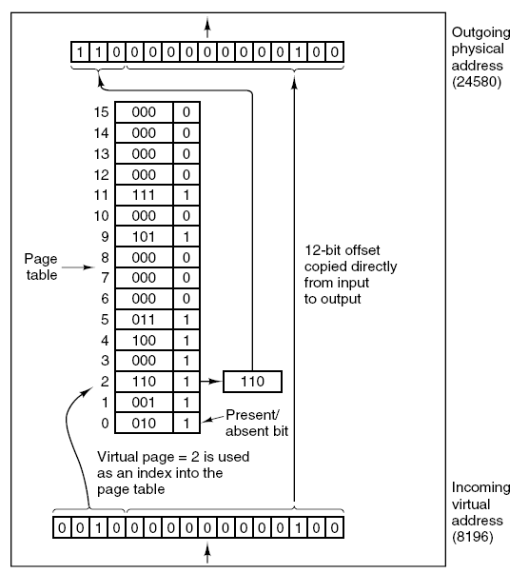

Slide 27
Paging
Operating system maintains a page table for each process
  Contains the frame location for each page in the process
  Memory address consist of a page number and offset within the page

Slide 28
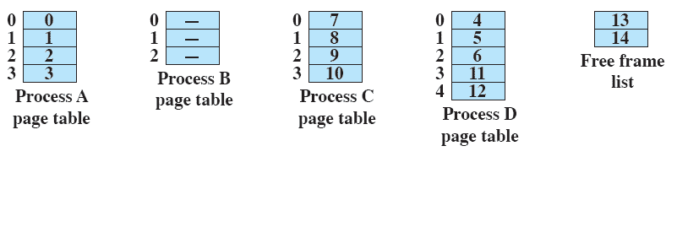
Page Table

Slide 29
Page Table
The only hardware required is a register
Points to the starting address of the Page table
Whenever, there is a context switch
The register points to the starting address of the new process’s page table

Slide 30
Page Table
Two major issues are:
  The Page table entries can be extremely large
  The mapping must be fast

Slide 31
Page Table Size
If we have
  32-bit addresses
  Page size = 4 KB = 2¹² B
  Possible Pages??
  2³²/2¹²
  = 2²⁰
  = 10⁶
  = 1 Million
➔ We need 1 Million Page Table entries in RAM all the Time!!!

Slide 32
Page Table Size
Increasing the Page size will decrease the number of pages
…but…
More Internal Fragmentation

Slide 33
RAM Vs. Registers
Remember:
  If referring to RAM is like walking
  Then referring a Register is like flying an aero plane

Slide 34
Implementation of Page Table
Page table is kept in main memory.
Page-table base register (PTBR) points to the page table.
Page-table length register (PRLR) indicates size of the page table.
In this scheme every data/instruction access requires two memory accesses. One for the page table and one for the data/instruction.
The two memory access problem can be solved by the use of a special fast-lookup hardware cache called associative memory or translation look-aside buffers (TLBs)
Operating System Concepts

Slide 35
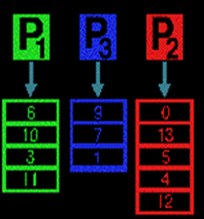
Where is the Page Table Stored?
Page Table Base Register
(PTBR)
Points to the Page Table of Running Process
Operating System

Slide 36
Solution
Keep a number of fast hardware registers
When a process starts
OS loads the registers with the Process’s entire Page table
Process’s Page table is available in RAM
During execution no memory references are required for Page tables
But is expensive, if page size is large

Slide 37
Associative Memory
Associative memory – parallel search
Address translation (A´, A´´)
  If A´ is in associative register, get frame # out.
  Otherwise get frame # from page table in memory
Page #
Frame #
Operating System Concepts

Slide 38

Paging Hardware With TLB
Operating System Concepts

Slide 39
Effective Access Time
Associative Lookup = ε time unit
Assume memory cycle time is 1 microsecond
Hit ratio – percentage of times that a page number is found in the associative registers; ration related to number of associative registers.
Hit ratio = α
Effective Access Time (EAT)
EAT = (1 + ε) α + (2 + ε)(1 – α)
= 2 + ε – α
Operating System Concepts

Slide 40
Translation Look-aside Buffer (TLB)
A better solution is TLB:
  A special, small, fast-lookup Hardware cache
The TLB contains a few Page-Table entries
Whenever, a virtual address is generated:
  The page number is presented to the TLB
  If the entry is found
    Its used to access memory
  Else (TLB miss)
    The actual Page table stored in RAM is used
We may would like to add this Page Table entry into TLB

Slide 41
Hit Ratio
Percentage of times a particular page is found in the TLB
20 ns to Search TLB
100 ns to Access Memory
➔ 120 ns to Access Memory when the Entry is in the TLB
➔ 220 ns to Access Memory when the Entry is not in the TLB
If Hit-Ratio = 80%
  Effective access time = 0.80 * 120 + 0.20 * 220 = 140 ns
If Hit-Ratio = 98%
  Effective access time = 0.98 * 120 + 0.02 * 220 = 122 ns

Slide 42
Translation Look-aside Buffer (TLB)
All entries in TLB may correspond to a single process
  The currently running process
  TLB must be erased/flushed on every context switch
Or it may have entries from multiple processes
  We need to distinguish between the Page Table entries from multiple processes
  So, each entry in TLB will also have a Process Identifier

Slide 43
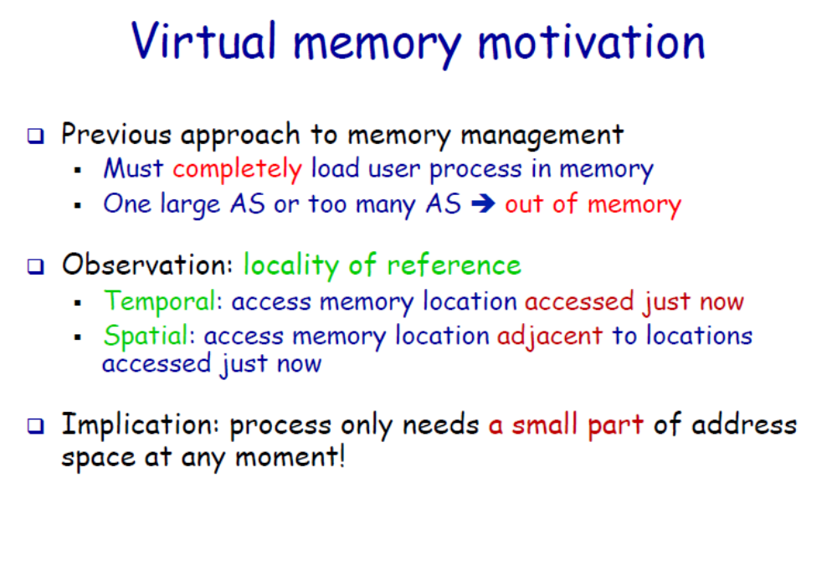

Slide 44
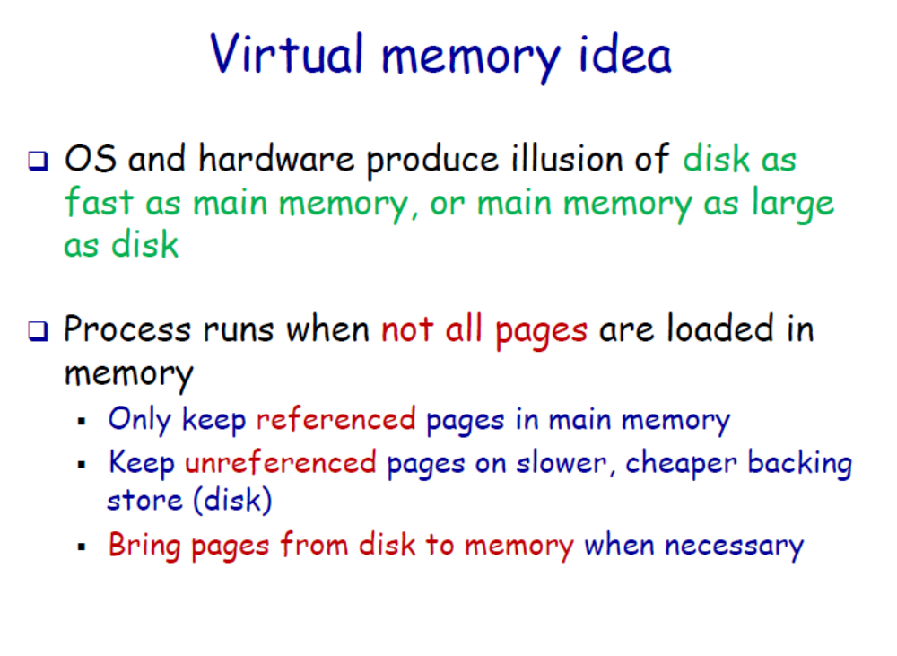


Slide 45
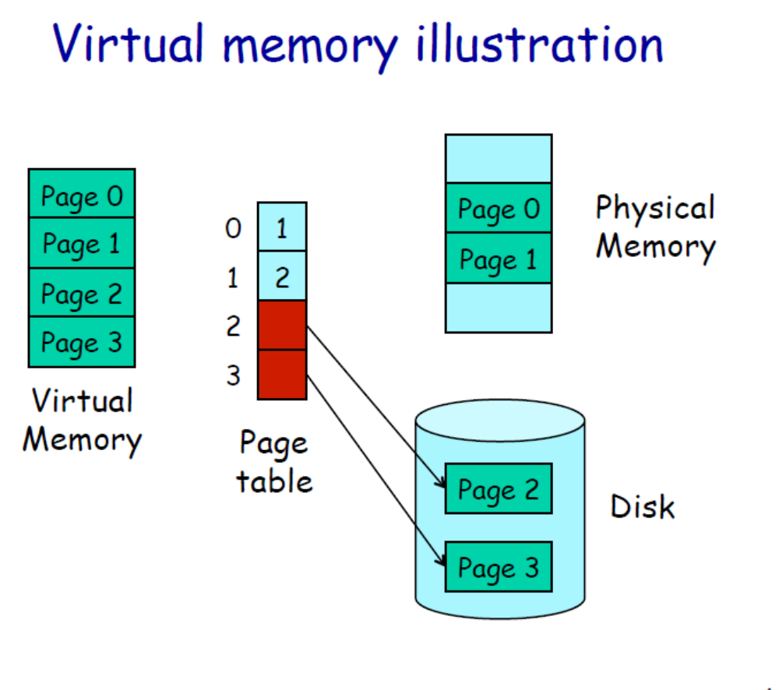

Slide 46
